Slide 1
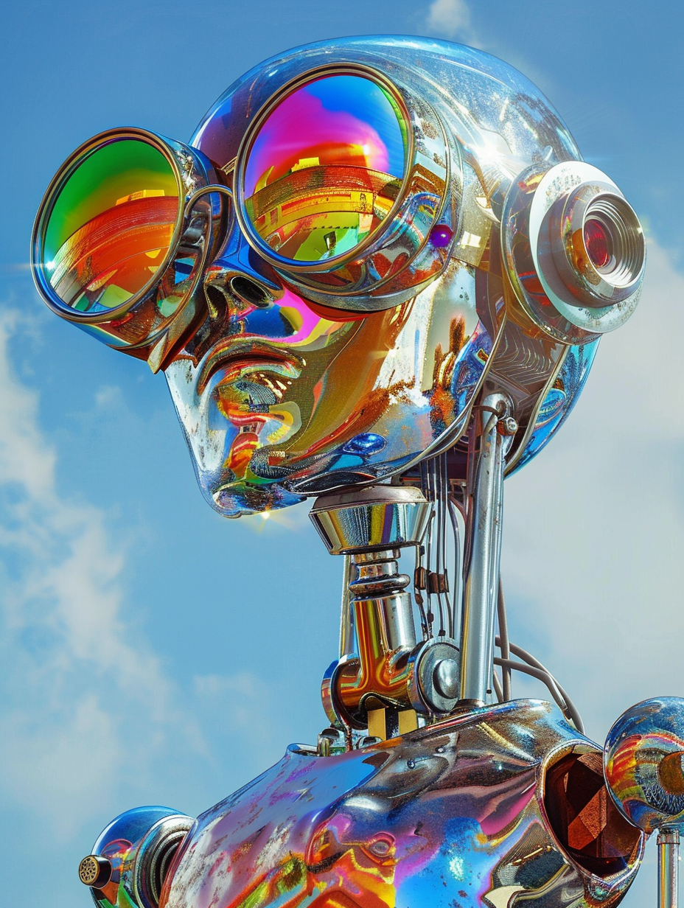

An Introduction to
Machine
Learning
Notes:
Welcome the audience and introduce yourself.
“Today, we’re diving into Machine Learning, an exciting field driving innovation across industries.”

Slide 2
BEFORE WE GET STARTED:
Please open the following tabs via the web browser:
https://bit.ly/41HqHzN - Link to slides & Exercise images
Slido.com – Link to live polls
https://bit.ly/3EktSUA - Link to Exercise
Notes:
Welcome the audience and introduce yourself.
“Today, we’re diving into Machine Learning, an exciting field driving innovation across industries.”

Slide 3

TODAY’S TOPICS
01
INTRODUCTION TO ARTIFICIAL INTELLIGENCE and machine learning
02
Case scenario of machine learning
03
exercise
04
reflection
05
Feedback and support
Notes:
"We’ll structure this session into key parts to ensure clarity.
"Briefly explain each topic
:Introduction to AI/ML: "We’ll start by defining AI and ML and setting expectations for this session."
Case Scenario: "We’ll look at a practical example to understand how ML solves problems."
Interactive Exercise: "A hands-on task will help solidify your understanding."
Reflection and Feedback: "We’ll close with a reflection to tie everything together and get your feedback."

Slide 4






TODAY’S TIMELINE
10 Minutes
10 Minutes
5 Minutes
Intro to AI & Machine Learning
Q&A
Exercise
5 Minutes
5 Minutes
5 Minutes
Quiz
Case Study using Machine Learning
Reflection & Summary
Notes:
Explain the schedule:
"We’ll spend 7-10 minutes on the introduction."
"Interactive elements, including a quiz and task, will take up most of the session."
"Reflection and Q&A will wrap things up.”
Emphasise time management: "I encourage active participation, but we’ll need to keep an eye on time to ensure we cover everything.

Slide 5
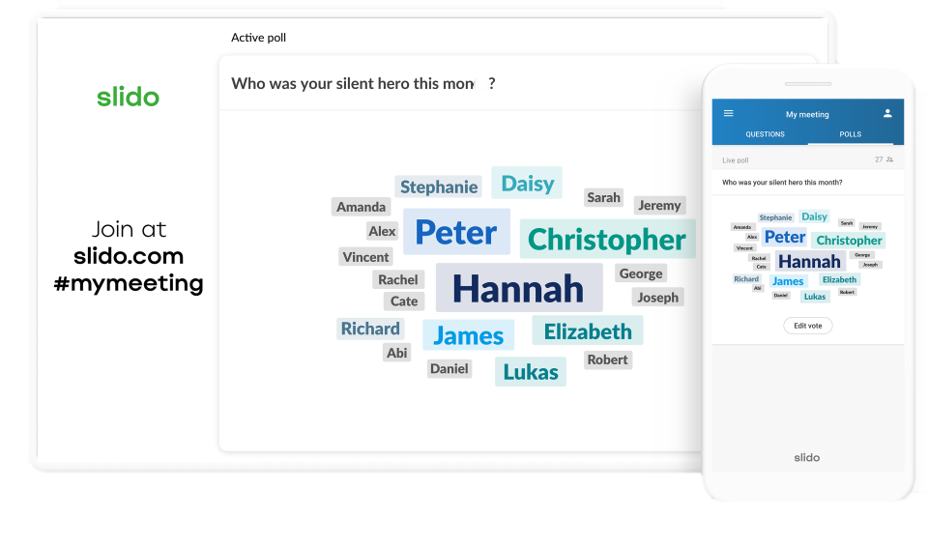
INTERACTIVE ACTIVITIES
To make the sessions more engaging, we're using interactive tools such as Slido for quizzes and other activities!
Notes:
"This session is designed to be engaging. We’ll use tools like Slido to make learning interactive.”
Demonstrate how to join Slido:
"Go to Slido.com and enter the code displayed.”. This will be on the next slide.
"Throughout the session, you’ll see polls, quizzes, and opportunities for Q&A.”
Encourage active participation: "Don’t hesitate to share your thoughts and ask questions."

Slide 6
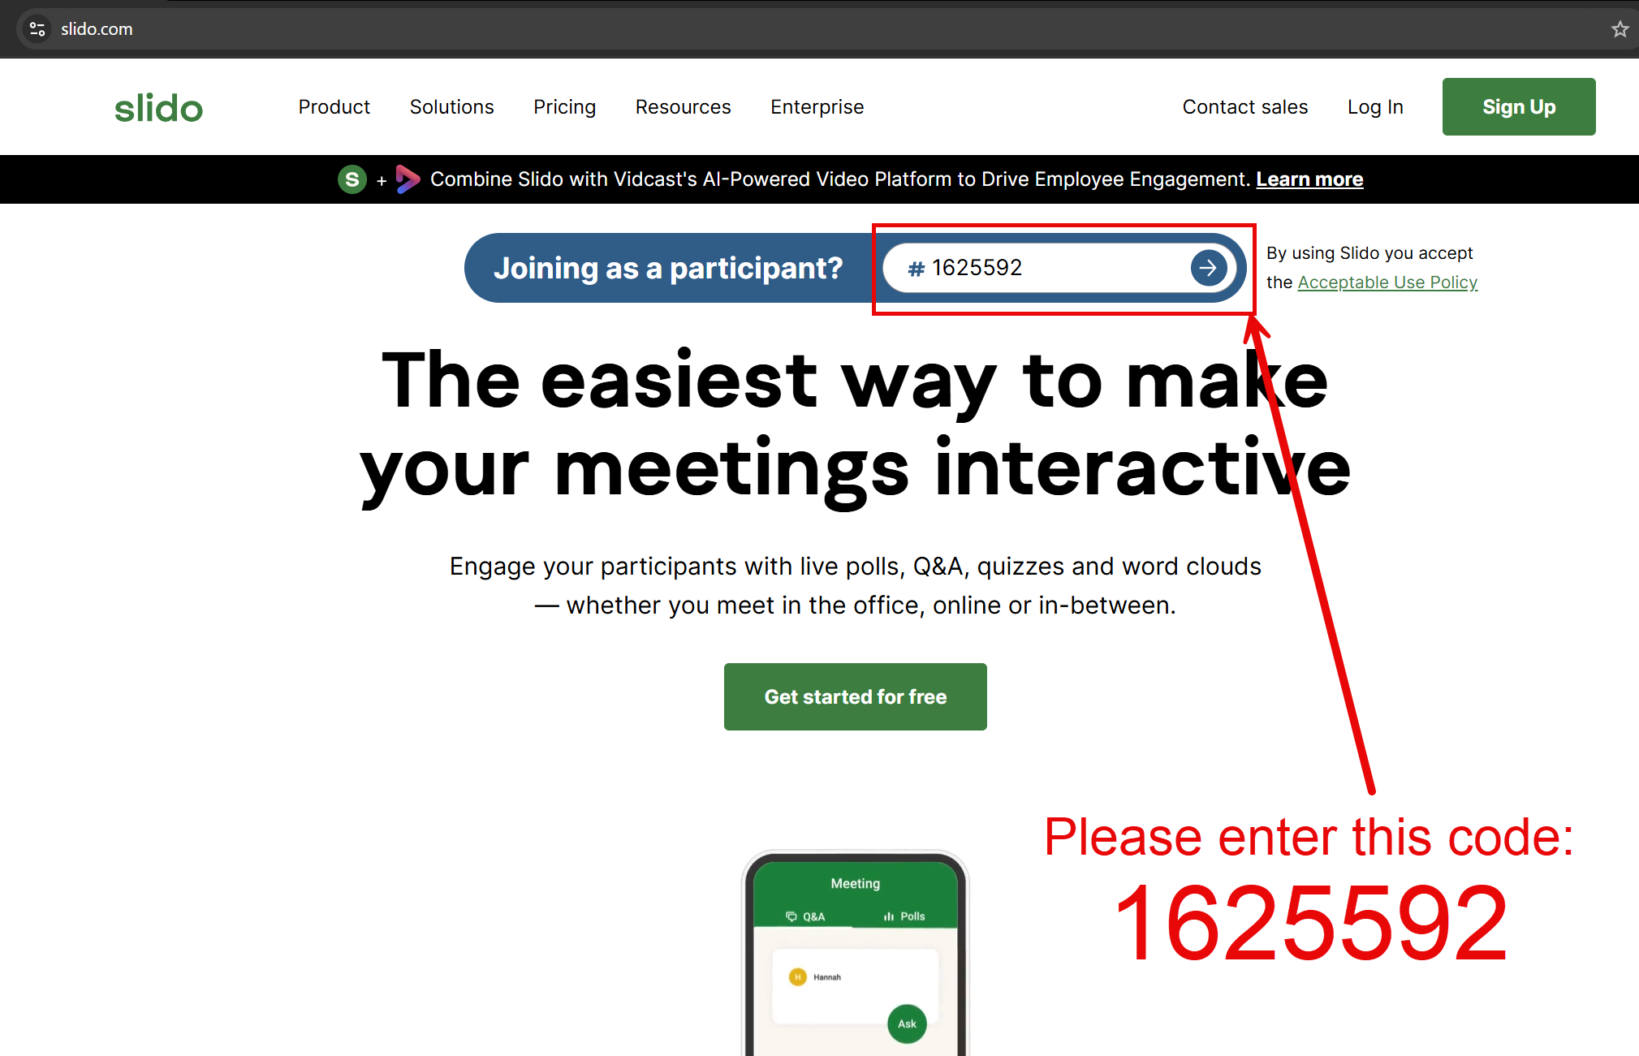
Notes:
"This session is designed to be engaging. We’ll use tools like Slido to make learning interactive.”
Demonstrate how to join Slido:
"Go to Slido.com and enter the code displayed.”. This will be on the next slide.
"Throughout the session, you’ll see polls, quizzes, and opportunities for Q&A.”
Encourage active participation: "Don’t hesitate to share your thoughts and ask questions."

Slide 7
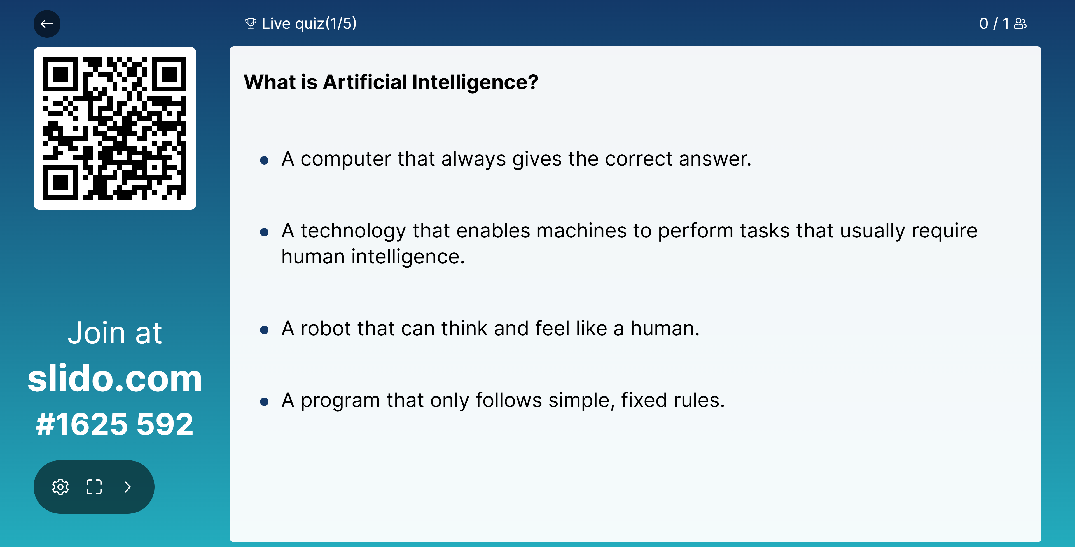

Slide 8
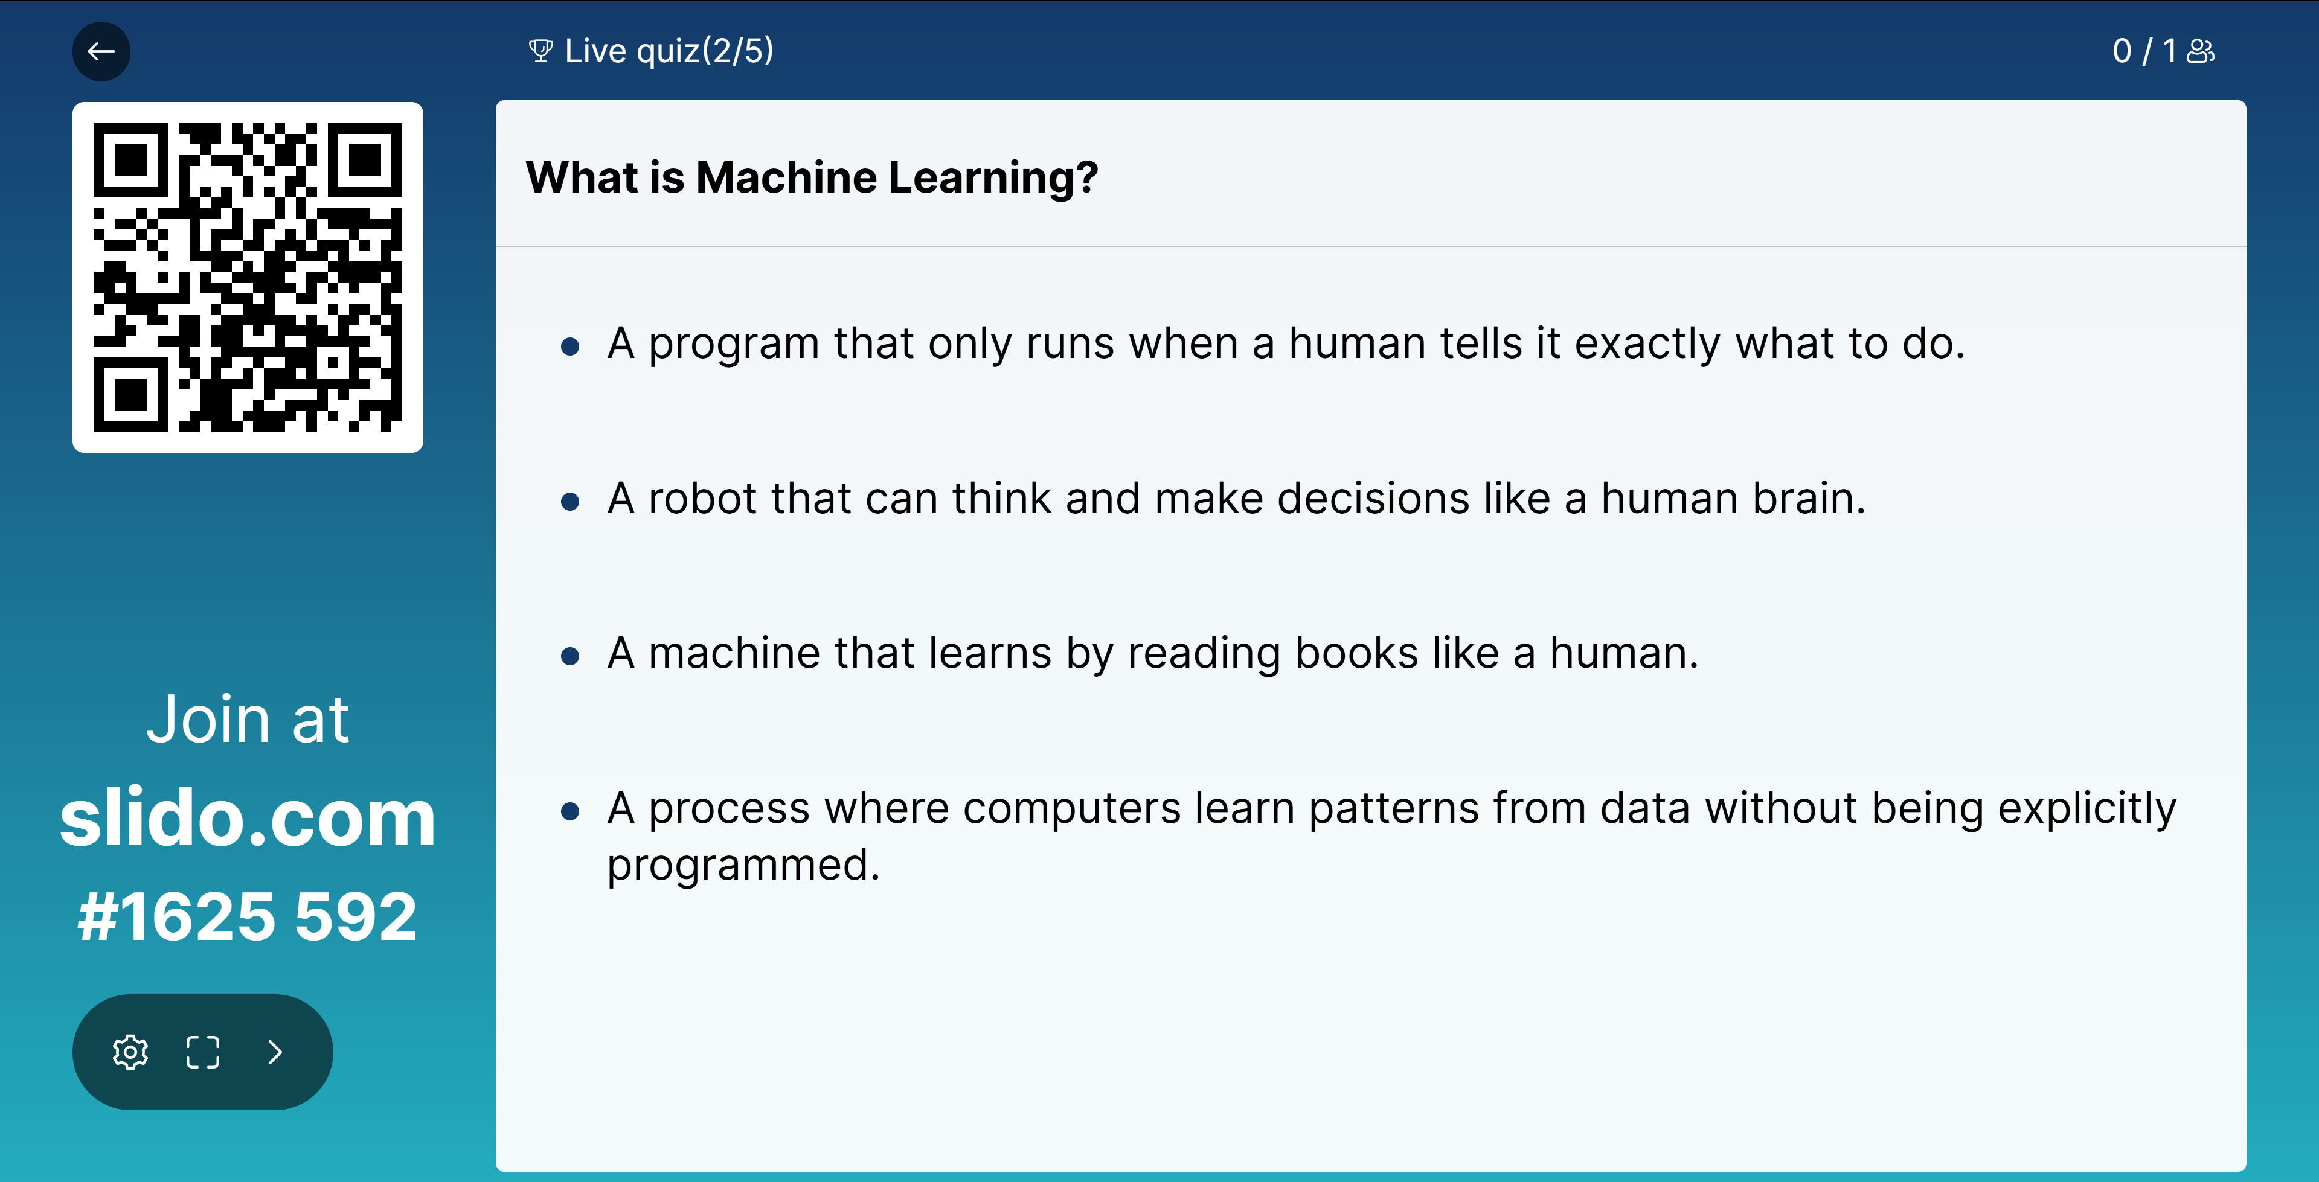

Slide 9

Chapter One:
Intro to Artificial Intelligence and Machine Learning

Slide 10


Introduction
What can we expect from this session?
An introductory understanding of Machine Learning Tools and Technologies.
An idea of how and why Machine Learning can be used in the real world.
This will not force you to become professional programmers!
Notes:
"Here’s what you can expect from today’s session:”
"First, you’ll gain a basic understanding of Machine Learning tools and technologies."
"Second, you’ll see practical examples of how and why Machine Learning is applied in the real world."
"Finally, don’t worry—this session isn’t about turning you into professional programmers. It’s about understanding the concepts, not writing complex code."

Slide 11

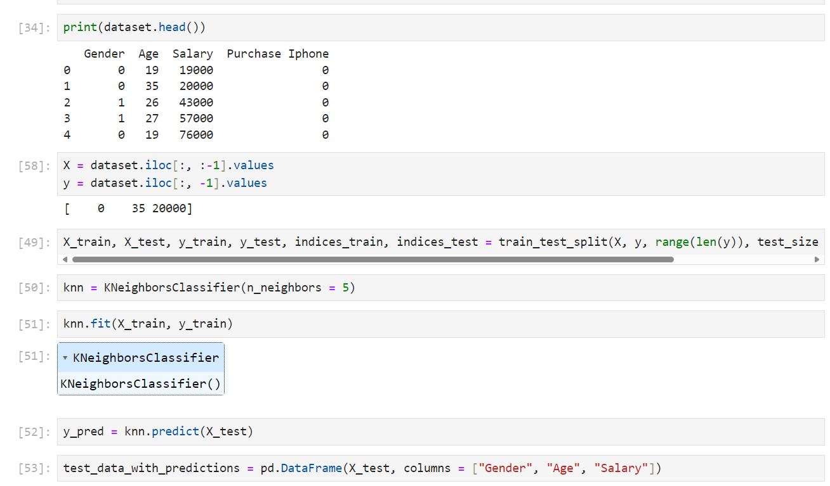
Introduction
What is Machine Learning?
Expectations VS Reality
VS
Notes:
"AI is often imagined as futuristic robots taking over the world, but the reality is much more grounded.”
"Machine Learning is really about using code, like what you see here, to analyse data and make predictions.”
“In this example, we’re training a simple machine learning model called K-Nearest Neighbours to predict outcomes from data like age, salary, and product purchase history.”
"This kind of practical problem-solving powers tools like Netflix recommendations, spam filters, and stock predictions.”
"While robots are a fun idea, ML is fundamentally about turning data into usable insights."

Slide 12

Introduction
01
Machine Learning is a technology that “allows computers to perform specific tasks intelligently, by learning from examples”.
02
To do so, we use Machine Learning algorithms. Most of these work using complex mathematical operations.
Notes:
Define ML in simple terms:
"Machine Learning is teaching computers to learn patterns from data rather than programming them for every task."
Distinguish ML from traditional programming:
"Traditional programming involves writing rules; ML lets the computer figure out patterns and make decisions."
Mention practical use cases:
"Examples include email spam filters, product recommendations, and autonomous vehicles."

Slide 13

Useful Vocabulary
01
Artificial Intelligence: a machine that can perceive its environment and learn from it, with the goal of performing a given task and/or achieve certain goals.
02
Machine Learning: algorithms capable of learning from data to recognise patterns, and generalise these patterns to new unseen data.
03
Deep Learning: subset of Machine Learning that uses Neural Networks to learn from data and recognise patterns.
Notes:
Artificial Intelligence: "Broadly refers to machines that mimic human intelligence.”
Machine Learning: "A subset of AI focused on learning from data to make predictions.”
Deep Learning: "A subset of ML that uses neural networks to solve complex problems.”
This leads to the History of technology to show the development and how they are all connected.

Slide 14
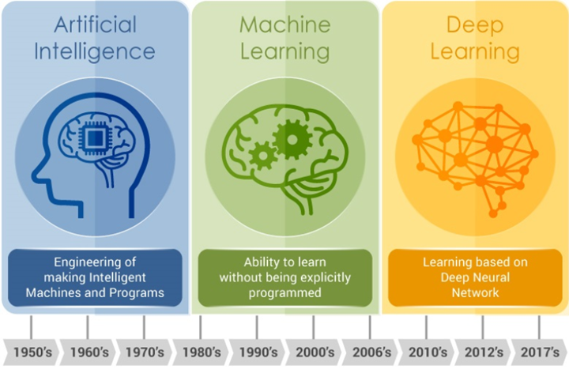
History of the technology
Artificial Intelligence
Machine Learning
Deep Learning
Notes:
"Previously, we defined AI, ML, and Deep Learning. Now, let’s see how they evolved.”
"AI started in the 1950s, ML emerged in the 1990s, and Deep Learning became prominent in the 2010s.”
"The diagram shows their relationship: Deep Learning is a subset of ML, which is part of AI.”
"This progression shows how these fields build on each other to create smarter systems."

Slide 15

Examples of Machine Learning
01
Wildlife Conservation: species identification using
AI-powered cameras
Using AI for Wildlife Population Conservation - Google (about.google)
02
Healthcare: tumor detection using Deep Learning
Applied machine learning in cancer research: A systematic review for patient diagnosis, classification and prognosis - PMC (nih.gov)
03
Language Learning: automatic exercise
generation and correction
The Amazing Ways Duolingo Is Using Artificial Intelligence To Deliver Free Language Learning (forbes.com)
Notes:
"Here are three real-world examples of how Machine Learning is being applied today:
"Wildlife Conservation: "AI-powered cameras are helping identify species and monitor biodiversity to aid conservation efforts.”
Healthcare: "Deep Learning models are used to detect tumours, improving early diagnosis and treatment planning."
Language Learning: "Apps like Duolingo use ML to personalise exercises, making learning more engaging and efficient."
"These examples highlight the diverse impact of ML across industries, from environmental protection to education and healthcare."

Slide 16
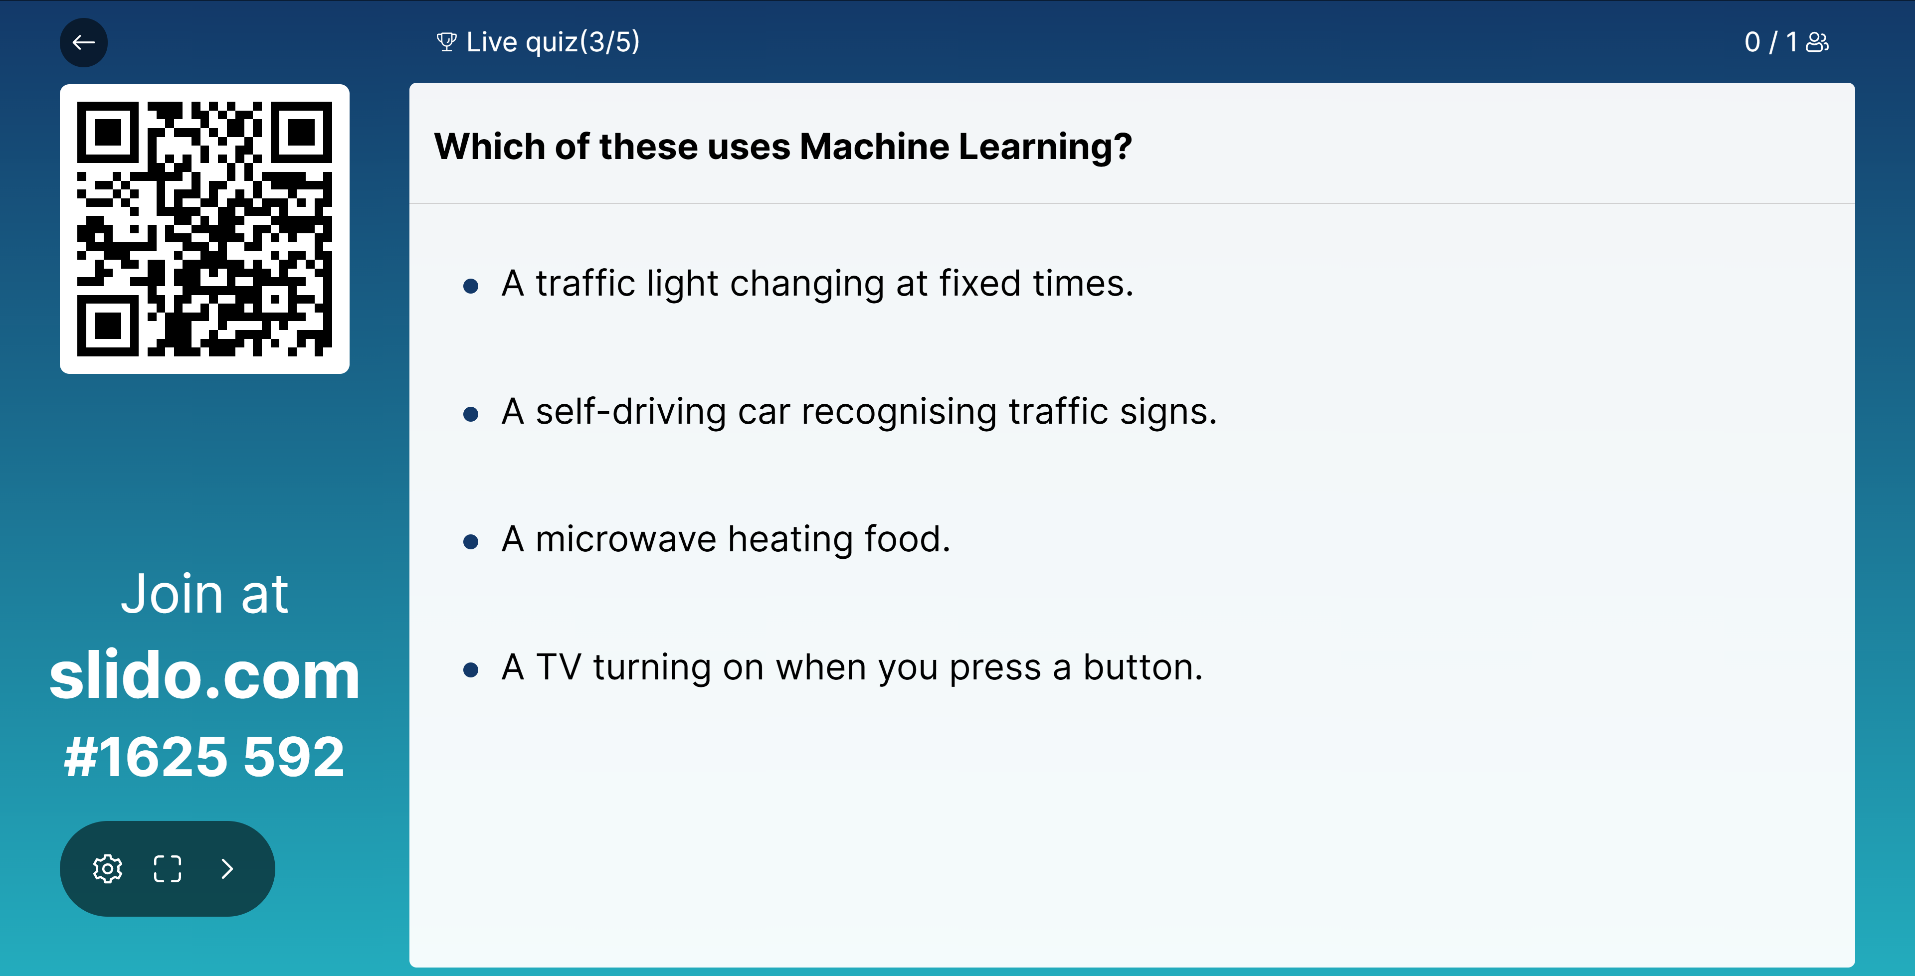
Notes:
"Here are three real-world examples of how Machine Learning is being applied today:
"Wildlife Conservation: "AI-powered cameras are helping identify species and monitor biodiversity to aid conservation efforts.”
Healthcare: "Deep Learning models are used to detect tumours, improving early diagnosis and treatment planning."
Language Learning: "Apps like Duolingo use ML to personalise exercises, making learning more engaging and efficient."
"These examples highlight the diverse impact of ML across industries, from environmental protection to education and healthcare."

Slide 17

Creating a Machine Learning Script:
Task Breakdown

Slide 18

Case Scenario
You work in the construction industry.
You are monitoring thousands of construction sites across the UK.
You do have a planned end date for each of these but as we know, constructions often run late.
Using images of the construction site, you can predict how many more days a construction is likely to take.
Notes:
"Imagine you’re responsible for managing thousands of construction sites across the UK, each with a planned completion date.”
"As we know, delays are common in construction, making it hard to predict when projects will actually finish.”
"Using images of construction sites, we can leverage Machine Learning to predict how many more days a project might take to complete.”
"This allows for better planning, resource allocation, and overall efficiency."

Slide 19

Case Scenario
01
Collect and process historical annotated data. Example: 1’000 images of construction sites, annotated for how many more days the construction took.
02
Select a relevant ML algorithm (or create it – only for experts/researchers). Example: logistic regression, SVM, etc.
03
Train it on the annotated data: the model will start recognising patterns. For example, every time at least 4 walls are detected in the picture, the construction is likely to finish within the next 500 days.
04
Test it on your new data: give it an image that it has never seen before and ask for a prediction. If it guesses correctly, you can use your model to predict future outcomes.
Notes:
"Let’s break down how we’d build a Machine Learning solution for this scenario.”
Data Collection: "We start by gathering and annotating historical data, like images from past projects showing how long they took to finish."
Algorithm Selection: "We then choose a suitable ML algorithm, such as logistic regression or SVM, depending on the data."
Model Training: "Next, we train the model on this data so it can identify patterns, like the presence of walls indicating progress."
Model Testing: "Finally, we test the model with new images to see how accurately it predicts the remaining time."
"This process is iterative, meaning we refine the model to improve accuracy over time."

Slide 20

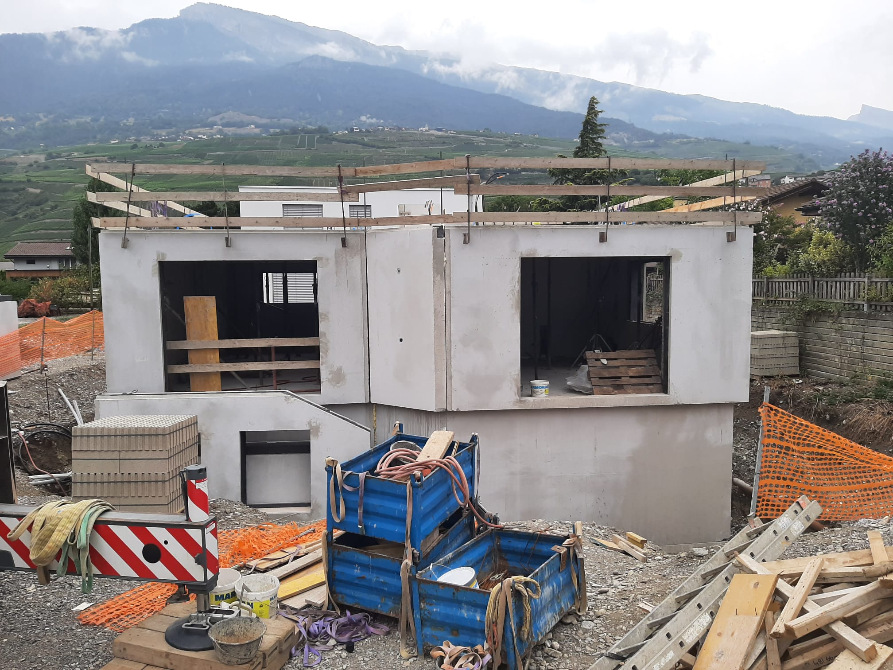
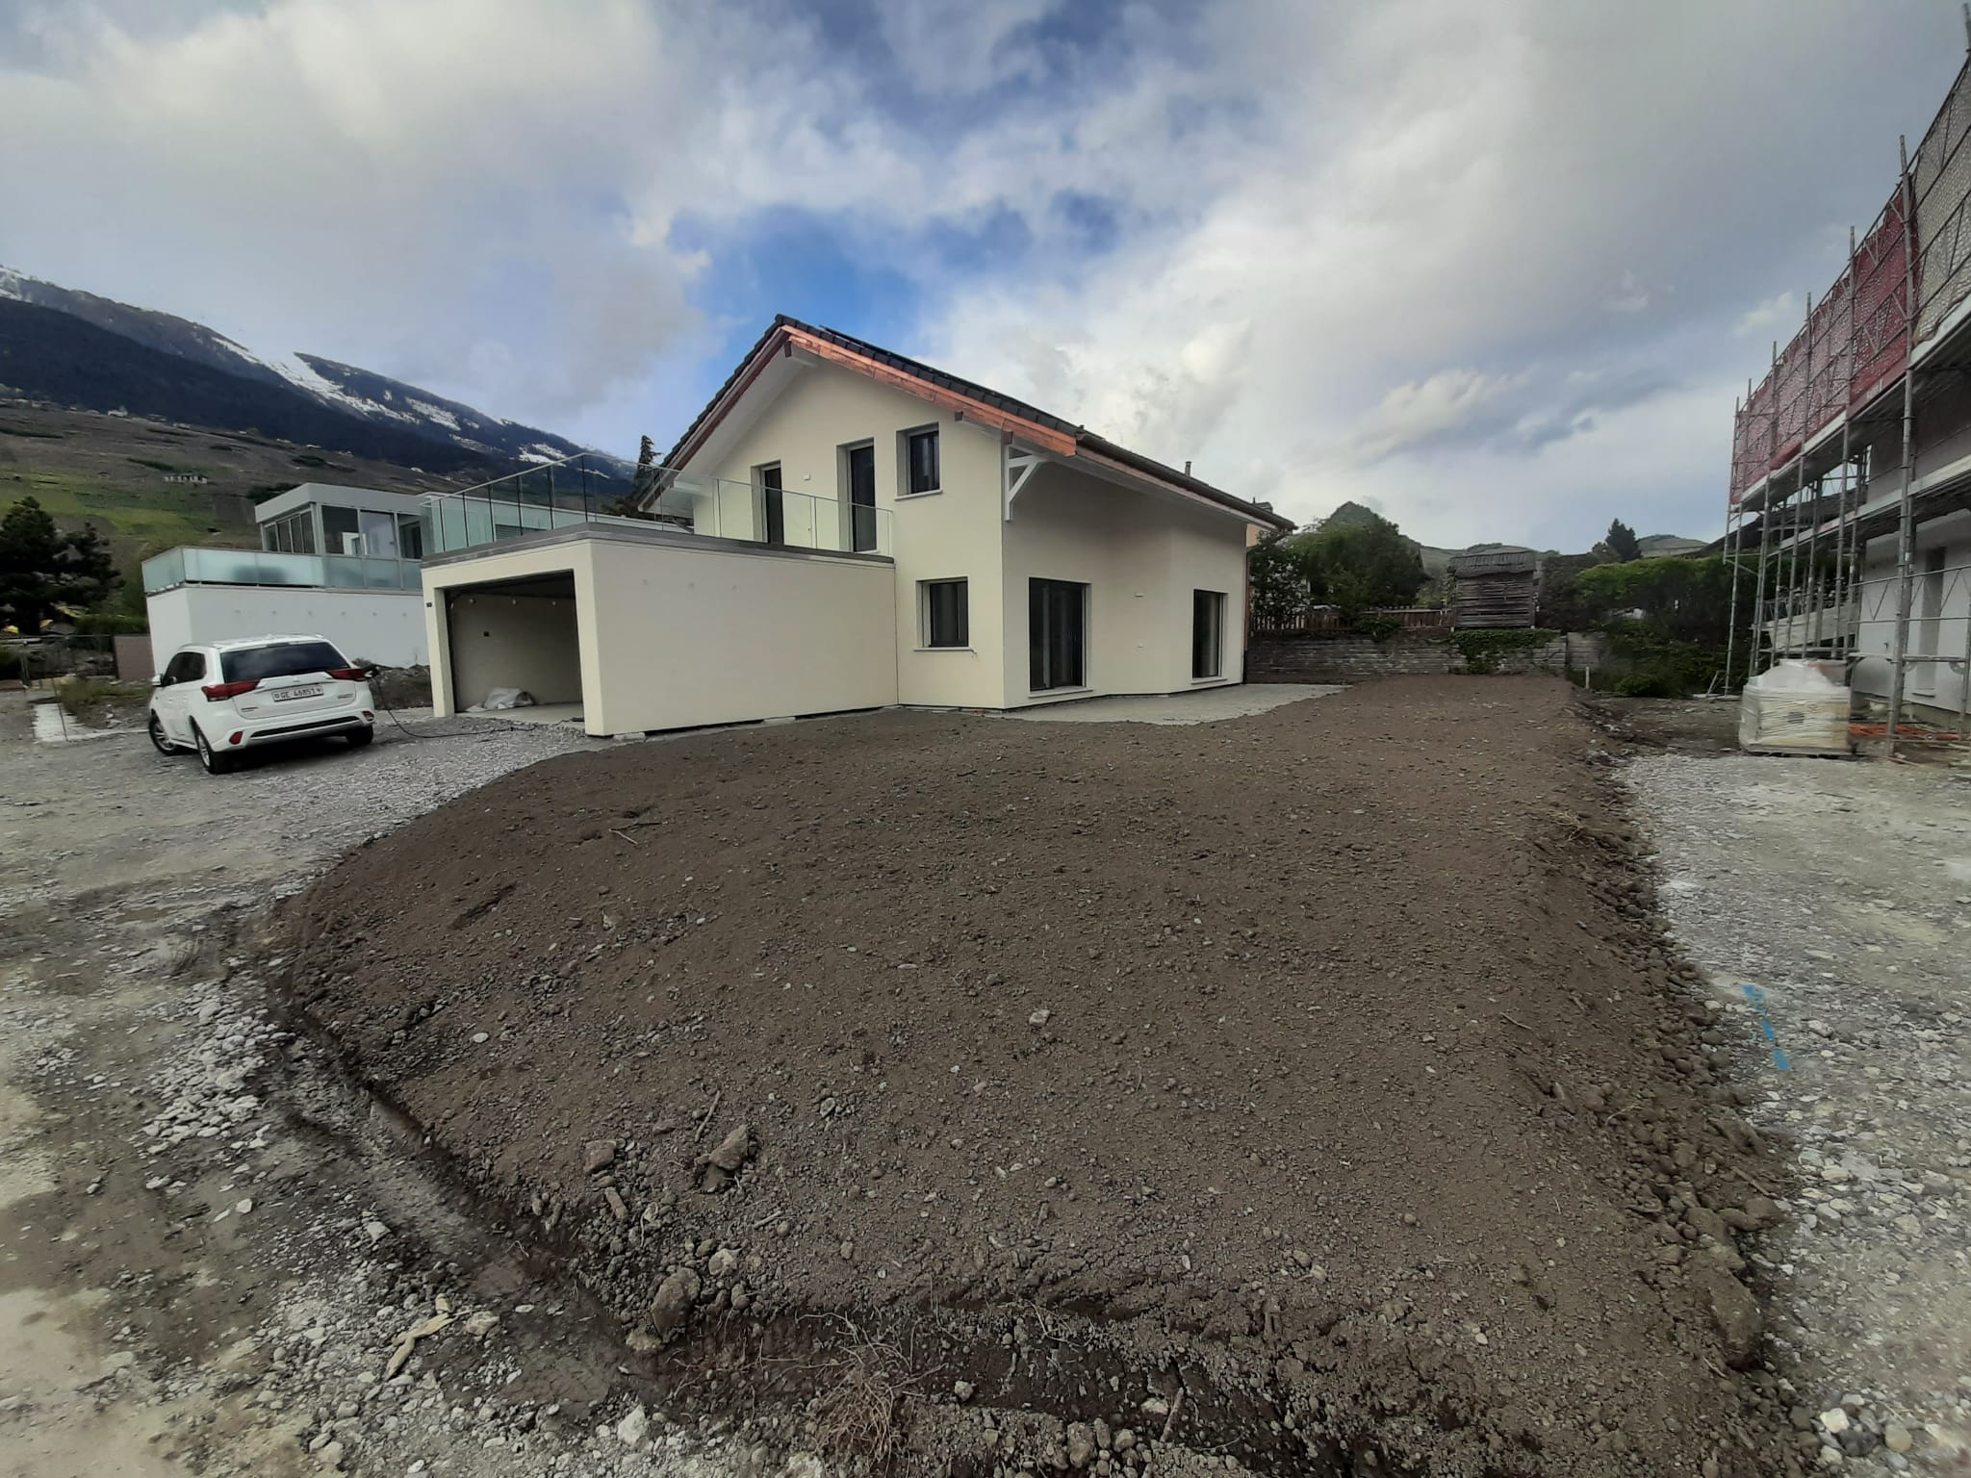
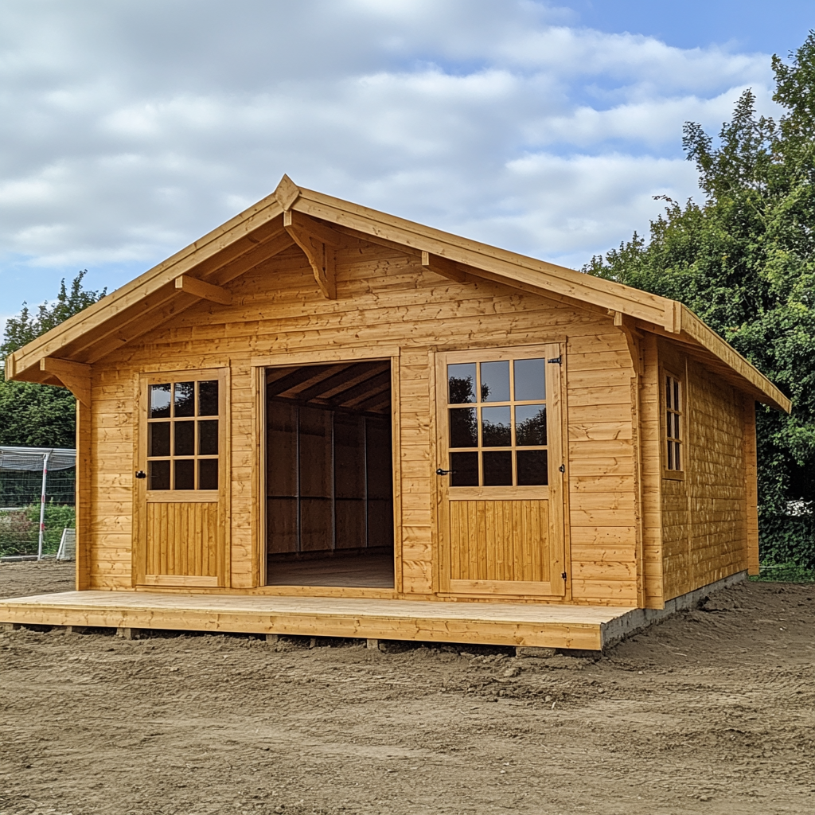

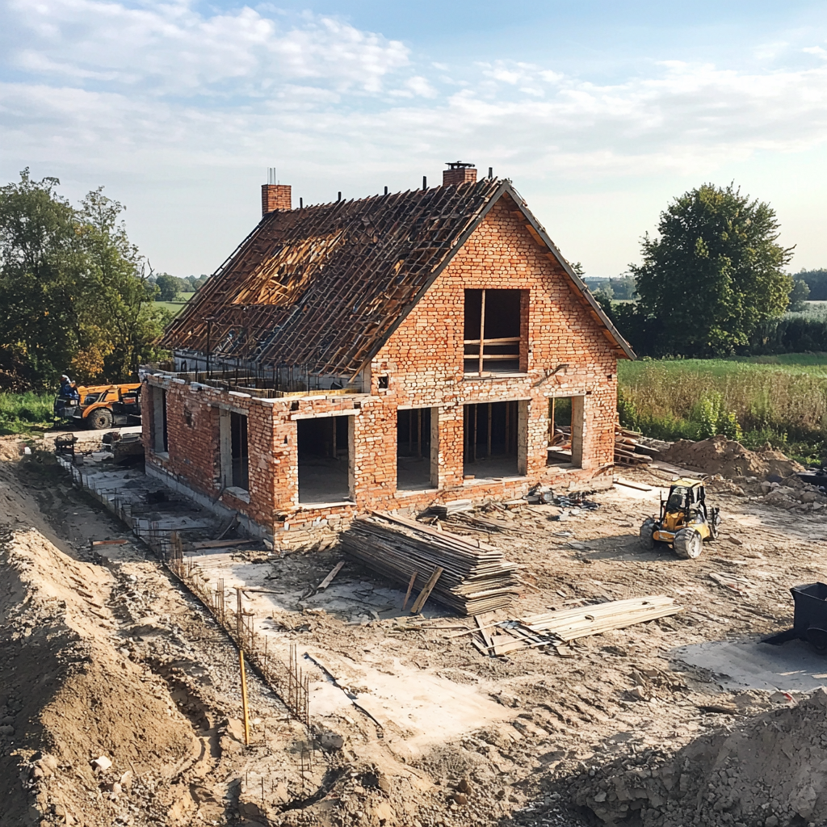
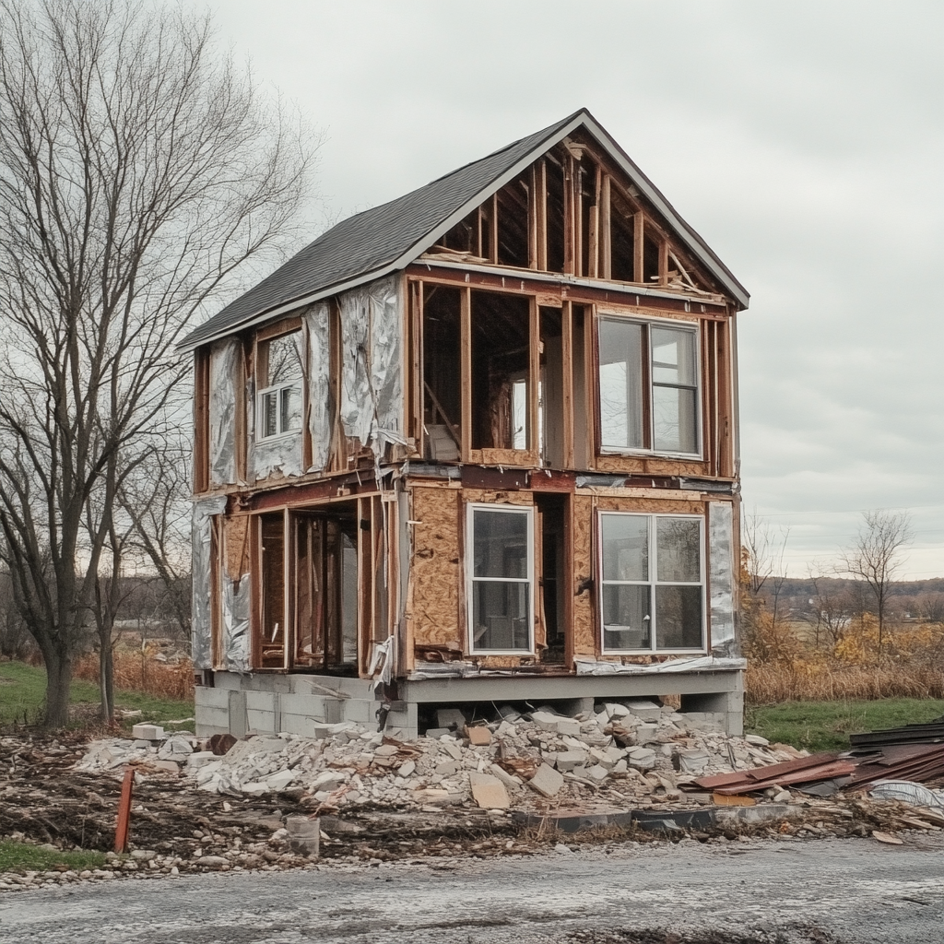
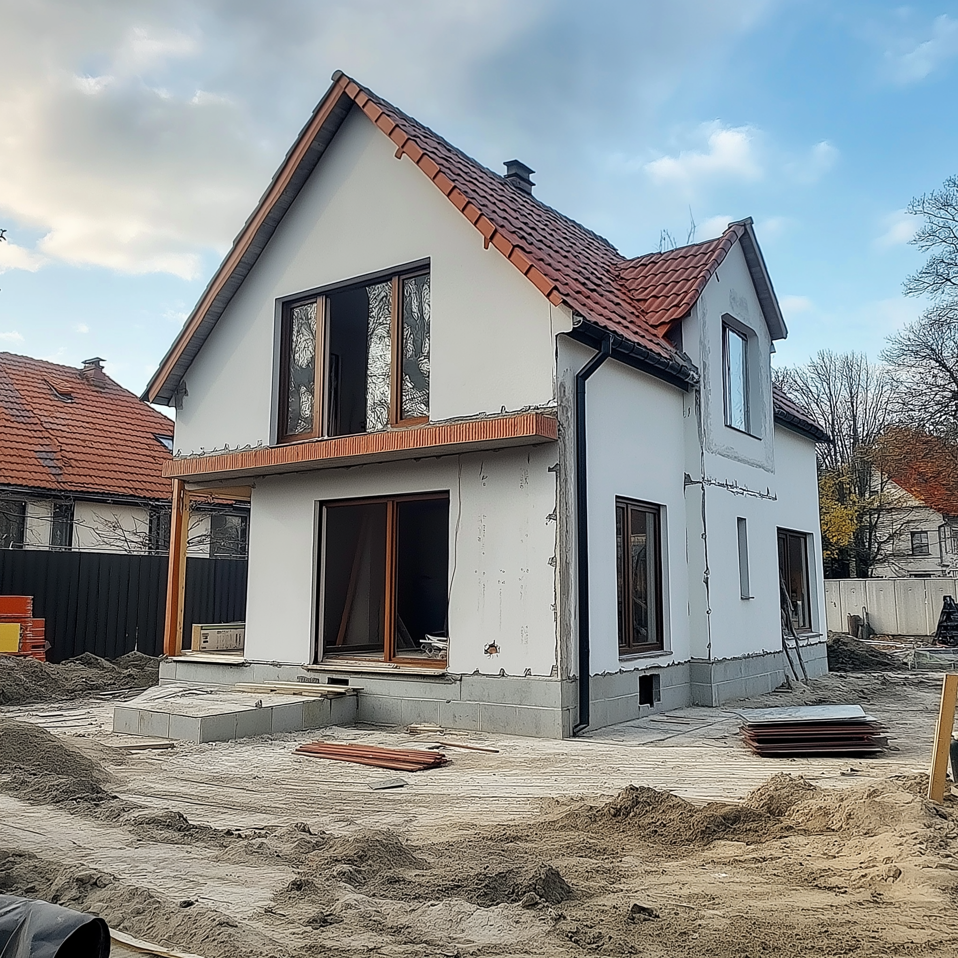

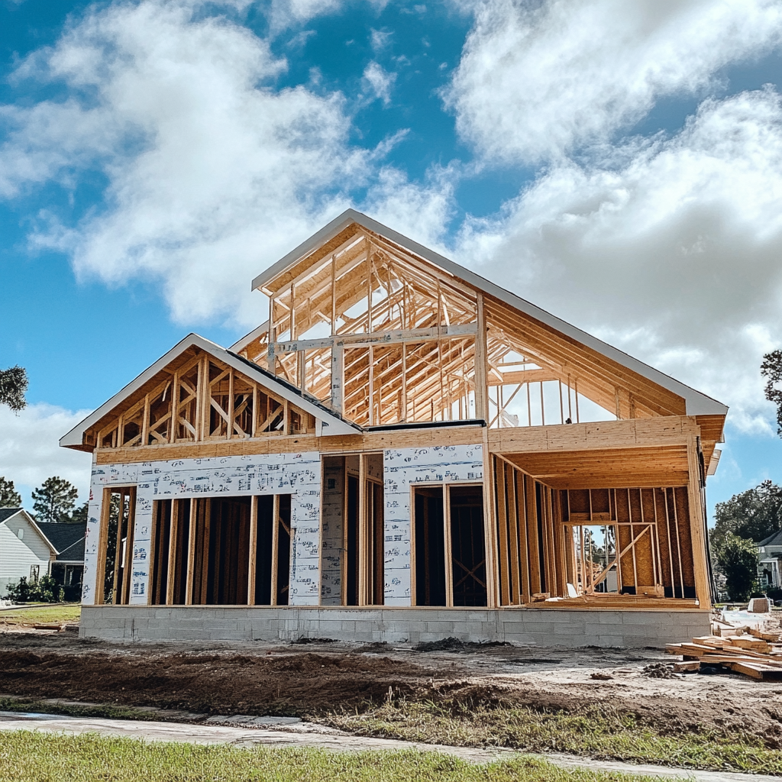
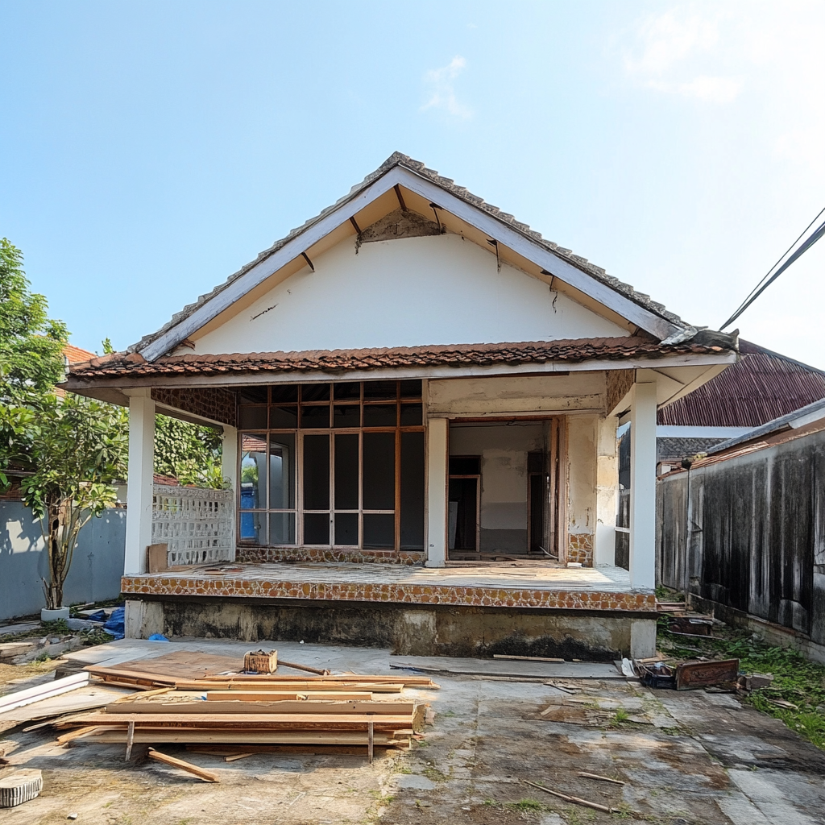
Case Scenario
Collect and process historical annotated data.
Example: 1’000 images of construction sites, annotated for how many more days the construction took.
1
Training
Data
125
256
17
33
70%-80%
487
128
42
225
Historical annotated data: images of past projects that are annotated for how many more days the construction took.
30%-20%
Test
Data
97
185
122
Notes:
"The first step in building our Machine Learning solution is to collect and annotate historical data.”
"For example, we might use 1,000 images of construction sites, each annotated with how many days the construction took to complete.”
"The data is then split into two sets:
Training Data (70-80%): This is used to teach the model.
Test Data (20-30%): This is used later to validate the model's accuracy."
"This ensures the model learns from past examples and is evaluated on unseen data."

Slide 21

Case Scenario
2
Select a relevant ML algorithm (or create it – only for experts/researchers). Examples: logistic regression, SVM, etc.
Different algorithm will work more or less efficiently on different types of data…
Linear Regression is useful if you want to predict a numeric value based on another numeric value: for example, predicting the age of a car based on its maximum speed.
Logistic Regression is useful to classify data into categories: for example, predicting whether an email is a spam or not based on its content.
7 Machine Learning Algorithms to Know: A Beginner's Guide
Notes:
"The next step is to choose the right algorithm for our problem.”
"Different algorithms are suited for different types of tasks.
For example:
Linear Regression: Predicts continuous numeric values.
Logistic Regression: Classifies data into categories, like 'on time' or 'delayed.'"
"Selecting the right algorithm depends on the type of data and the goal of the model.”
Be brief on this slide. This is just used if any learner wants to understand how it works.

Slide 22
Case Scenario
3
Train it on the training data: the model will start recognising patterns.
256
17
The model might detect that construction equipment is associated with a longer construction time
The model might detect that roofs are associated with a shorter construction time
Notes:
"Once the data is prepared, we train the model using the training data.”
"The model looks for patterns—for example:
Construction equipment might indicate longer project timelines.
A roof might suggest the project is nearing completion."
"By recognising these patterns, the model can start making predictions."

Slide 23
Case Scenario
4
Test it on your test data: give it an image that it has never seen before and ask for a prediction. If it guesses correctly, you can use your model to predict future outcomes.
Prediction
Reality
86
97
Determine your model’s accuracy – and think about whether it is good enough or if it requires tweaking!
?
Notes:
"Finally, we test the model using the test data, which it hasn’t seen before.”
"The model makes a prediction, which we compare to the actual outcome.”
"For example, if the model predicts 86 days remaining but the real value is 97 days, this gap helps us evaluate the model's accuracy.”
"Based on this, we decide whether the model is ready for use or needs further tweaking."

Slide 24
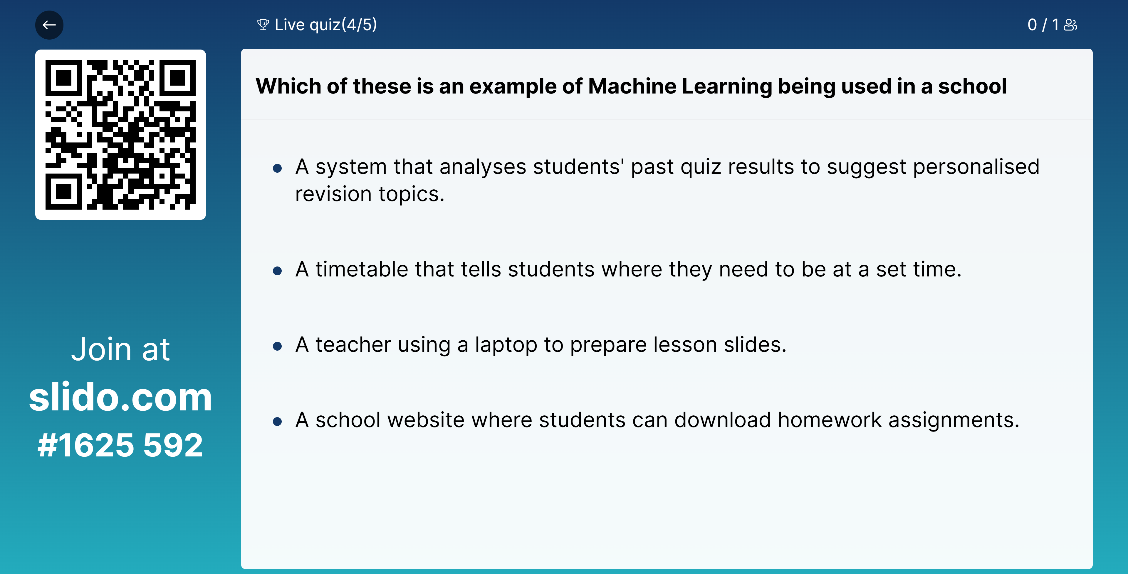

Slide 25




Where is Machine Learning used
Machine Learning is used in a whole variety of areas within data analytics!
Financial Services
Retail
Healthcare
Travel & Hospitality
Notes:
"Machine Learning is incredibly versatile and is used across a variety of industries for data analytics.”
"Here are some key examples:”
Financial Services: "ML is used for fraud detection, credit scoring, and market trend analysis."
Retail: "Retailers use it for personalised recommendations and inventory optimisation."
Healthcare: "In healthcare, ML powers medical imaging analysis and disease prediction."
Travel & Hospitality: "In travel, ML is used for dynamic pricing and improving customer experiences."
"These examples demonstrate how Machine Learning impacts our everyday lives in different ways."

Slide 26
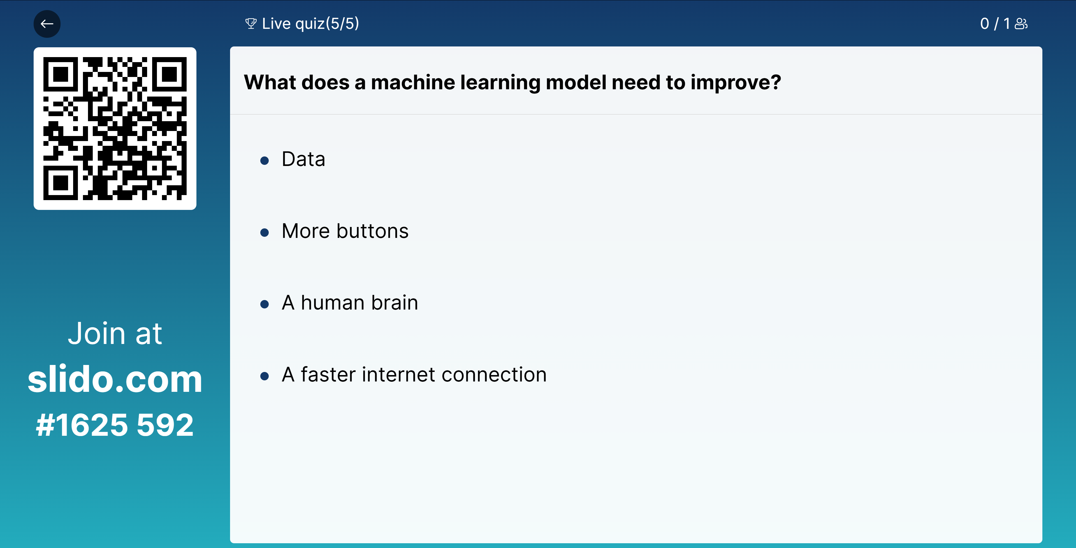

Slide 27






Reflection
What is the probability of this image being a cat or a dog?
Notes:
"This is an example of how a neural network processes an image to make predictions.”
"The image of this dog passes through the network, with each layer extracting features like edges, shapes, and patterns.”
"The final output assigns probabilities, indicating whether the image is more likely to be a dog or a cat.”
"Take a moment to think: what might the network predict for this image?"

Slide 28
What is the probability of this image being a cat or a dog?
95% Dog
5% Cat
Notes:
"Here’s the output from the neural network: it predicts a 95% probability that the image is a dog and 5% that it’s a cat.”
"This high confidence comes from the features the network associates with dogs, like the fur texture or the shape of the face.”
"But what if the model doesn’t perform as expected? That’s where data quality and diversity come into play."

Slide 29

What is the probability of this image being of my dog?
28% Luna
But why only 28%?
Notes:
"Now, let’s make the problem a bit more specific: What is the probability of this being my actual dog?”
"The model gives a 28% probability. Why is it lower? It’s likely because the training data didn’t include enough unique features of my dog.”
"This highlights a key limitation of ML models—they rely heavily on the data they’re trained on. Without specific examples, their accuracy decreases for niche cases."

Slide 30
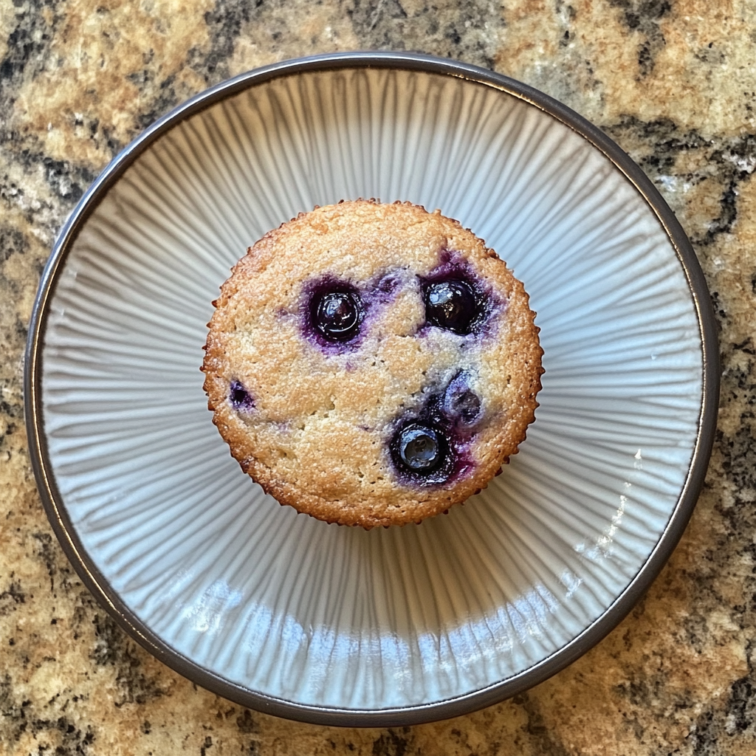










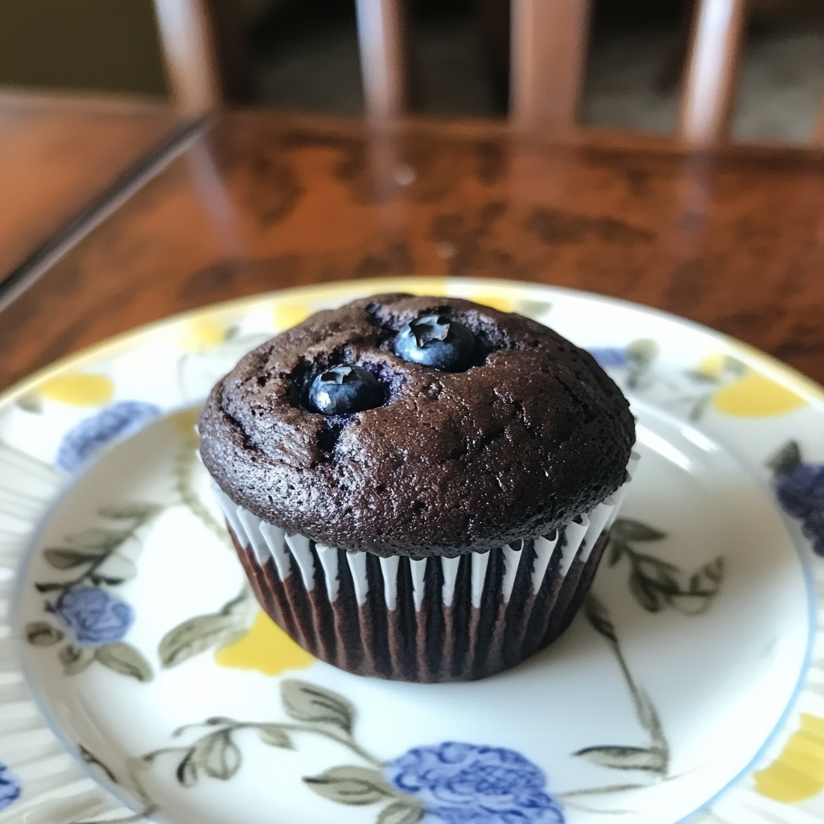

It all depends on the similarity within the dataset
One of the biggest challenges in Machine Learning is finding enough good-quality data.
Notes:
"The success of a Machine Learning algorithm heavily depends on the quality and quantity of the dataset it uses.”
"If you don’t have enough data, the algorithm won’t detect meaningful patterns, leading to unreliable predictions.”
"Poor-quality data, such as mislabelled or inconsistent data, can confuse the algorithm, resulting in incorrect patterns and poor outcomes.”
"This is why data collection and preprocessing are critical steps in Machine Learning."

Slide 31
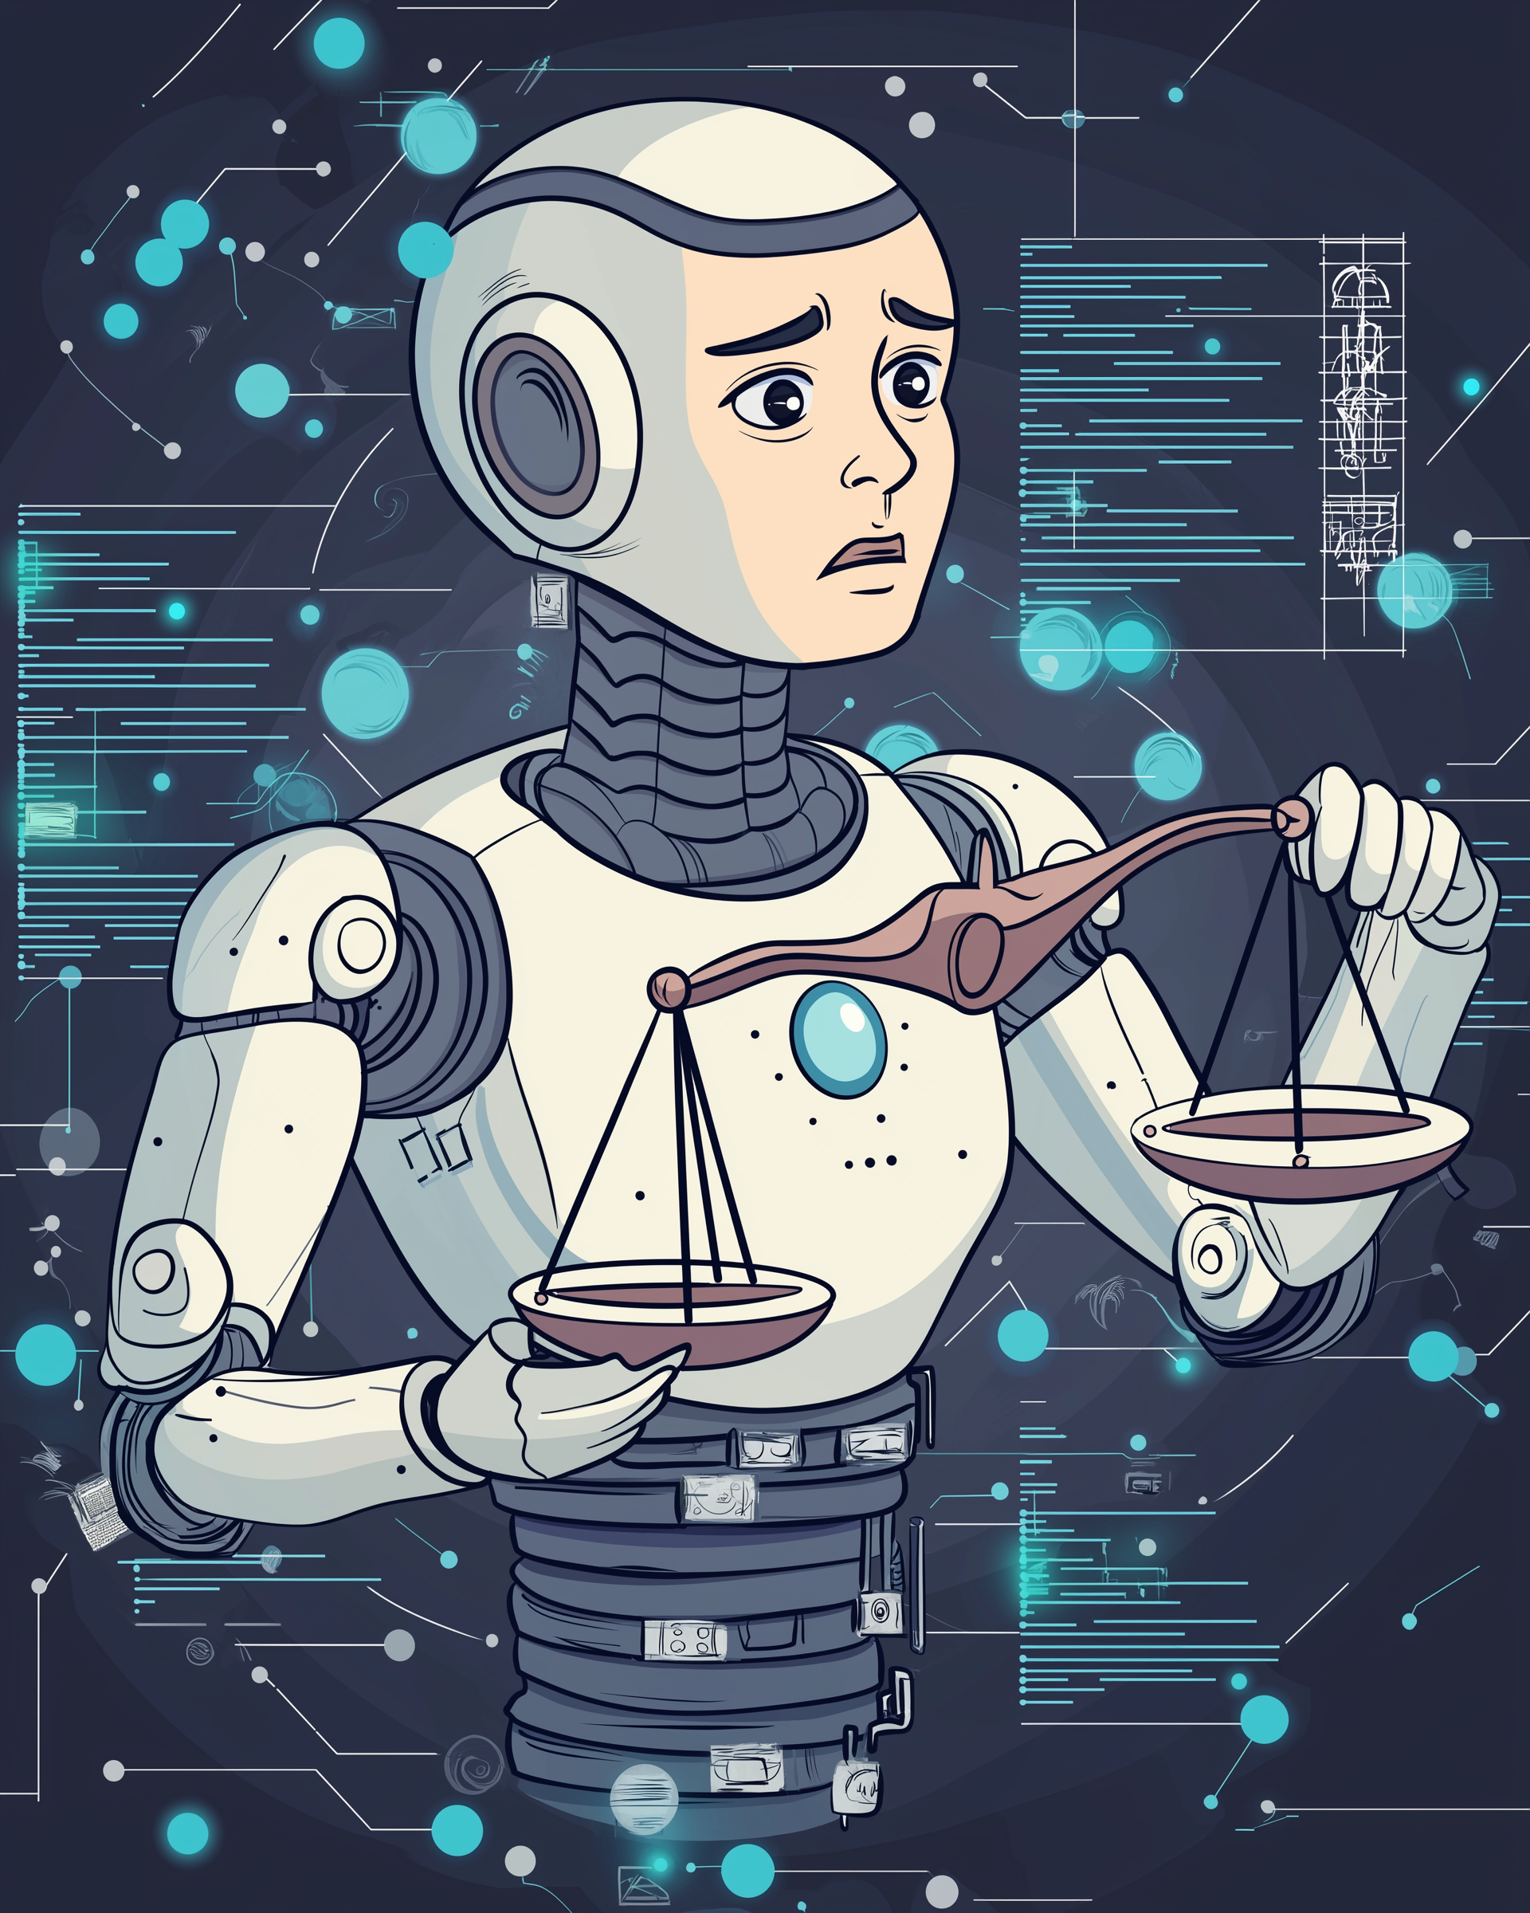
Ethics and AI
01 Bias in AI Models
AI systems can inherit biases from training data, leading to unfair outcomes (e.g., misclassification or discrimination).
02 Privacy and Data Security
AI relies on vast amounts of personal data, raising concerns about data misuse and breaches.
03 Accountability
Who is responsible for errors when AI makes decisions (e.g., hiring, medical diagnoses)?
04 Safe and Ethical Use
Examples: Misuse of AI in surveillance, warfare, or spreading misinformation.
Notes:
"When working with AI, ethical considerations are essential to address potential risks and challenges.
"Bias in AI Models: "AI systems can inherit biases from the data they’re trained on. This can lead to unfair outcomes, like misclassifying individuals or reinforcing stereotypes."
"For example, a hiring algorithm might favour one demographic over another due to biased training data."
Privacy and Data Security: "AI relies on vast amounts of personal data. This raises concerns about data misuse, breaches, and how personal information is stored and processed.”
Transparency in how data is collected and used is critical to building trust."
Accountability: "Who is responsible when AI makes a wrong decision?
For example, in cases of medical diagnoses or hiring, should we blame the developers, the data, or the organisation using the AI?"
"Accountability frameworks need to be established."
Safe and Ethical Use: "AI can be misused in areas like surveillance, warfare, or spreading misinformation, creating significant ethical dilemmas."
"It’s vital to ensure AI is used responsibly and for the benefit of society, not harm."
"These points highlight the need for careful consideration when designing and deploying AI systems."

Slide 32

Feedback & Support
Reading List
Data Analyst: Careers in data analysis
Data Analytics for Absolute Beginners: A Deconstructed Guide to Data Literacy: (Introduction to Data, Data Visualization, Business Intelligence & ... Science, Python & Statistics for Beginners): Amazon.co.uk: Theobald, Oliver: 9781081762469: Books​
Statistics for Absolute Beginners (Second Edition): 3 (Data Science, Python & Statistics for Beginners): Amazon.co.uk: Theobald, Oliver: 9798654976123: Books​
Python for Absolute Beginners (Data Science, Python & Statistics for Beginners): Amazon.co.uk: Theobald, Oliver: 9798748393300: Books​
Machine Learning for Absolute Beginners: A Plain English Introduction (Third Edition): 1 (Machine Learning with Python for Beginners): Amazon.co.uk: Theobald, Oliver: 9798558098426: Books​
Storytelling with Data: A Data Visualization Guide for Business Professionals: Amazon.co.uk: Nussbaumer Knaflic, Cole: 9781119002253: Books​
Storytelling with Data: Let′s Practice!: Amazon.co.uk: Nussbaumer Knaflic, Cole: 9781119621492: Books​
Pro Power BI Desktop​
Beginning DAX with Power BI​
Power Pivot and Power BI​
Mastering Machine Learning with Python in Six Steps​
Monetizing Machine Learning​
Introduction to Machine Learning with Python​
Advanced Data Analytics using Python​
Data Analysis and Visualisation using Python​
Data Analysis with Microsoft Excel​
Microsoft Excel and Business Data Analysis​
Websites:​
arrows.app - Neo4j Labs​
Learn to Code - for Free | Codecademy​
Find open data - data.gov.uk​
Soft Skills:​
Angeladuckworth.com/grit-scale​
https://www.w3schools.com/ ​
Learning and Development Services (microsoft.com)​
Notes:
"If you’re interested in learning more about Machine Learning and Data Analysis, here are some great resources to explore.”
"The books listed provide beginner-friendly introductions to topics like data analysis, Python, and Machine Learning. They’re excellent for building foundational knowledge.”
"The courses and tools listed, such as Power BI and Python-based analytics, are great for hands-on learning and skill development.”
"There are also websites, like Codecademy, that offer free coding lessons, and government resources for open data exploration.”
"Finally, for soft skills, I’ve included links like Angela Duckworth’s Grit Scale and Microsoft’s learning and development resources, which are useful for personal development."

Slide 33
Q&A
Got any questions? Ask away! 🚀
You can ask about anything we covered today or even about what it’s like to study Computer Science at university! 🔍💡
Notes:
"If you’re interested in learning more about Machine Learning and Data Analysis, here are some great resources to explore.”
"The books listed provide beginner-friendly introductions to topics like data analysis, Python, and Machine Learning. They’re excellent for building foundational knowledge.”
"The courses and tools listed, such as Power BI and Python-based analytics, are great for hands-on learning and skill development.”
"There are also websites, like Codecademy, that offer free coding lessons, and government resources for open data exploration.”
"Finally, for soft skills, I’ve included links like Angela Duckworth’s Grit Scale and Microsoft’s learning and development resources, which are useful for personal development."

